Slide 1
Keep it small and keep it simple: the neighborhood as ecosystem for integrated healthcare
Jos de Blok
Notes:
Titel
subtitel
Spreker

Slide 2
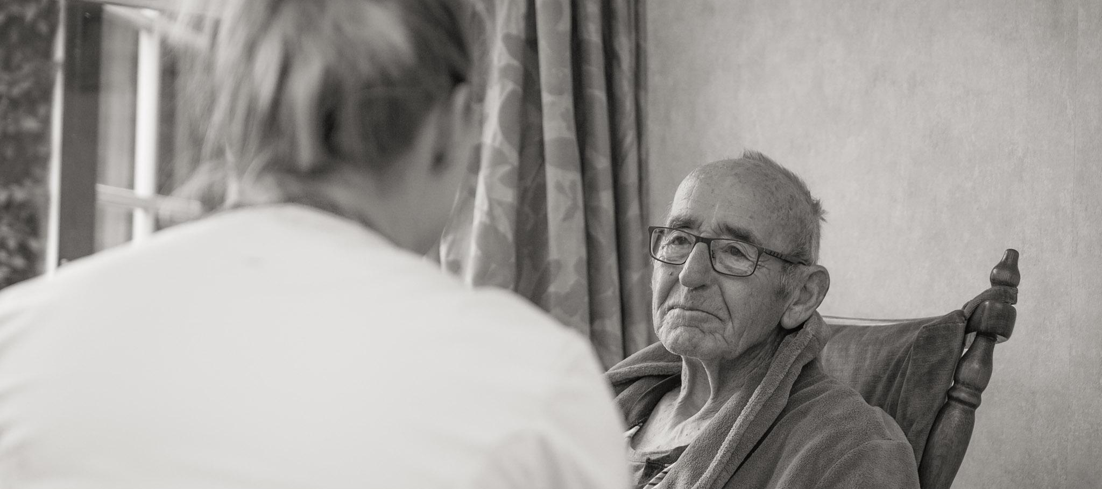
BUURTZORG QUICKSCAN
social healthcare
focus on relationships
solutions instead of indications
separated care and back office processes
buurtzorgweb- and square, knowledge, information, communication
scale of the neighborhood
© 2010 Buurtzorg International Holding BV - All Rights Reserved

Slide 3
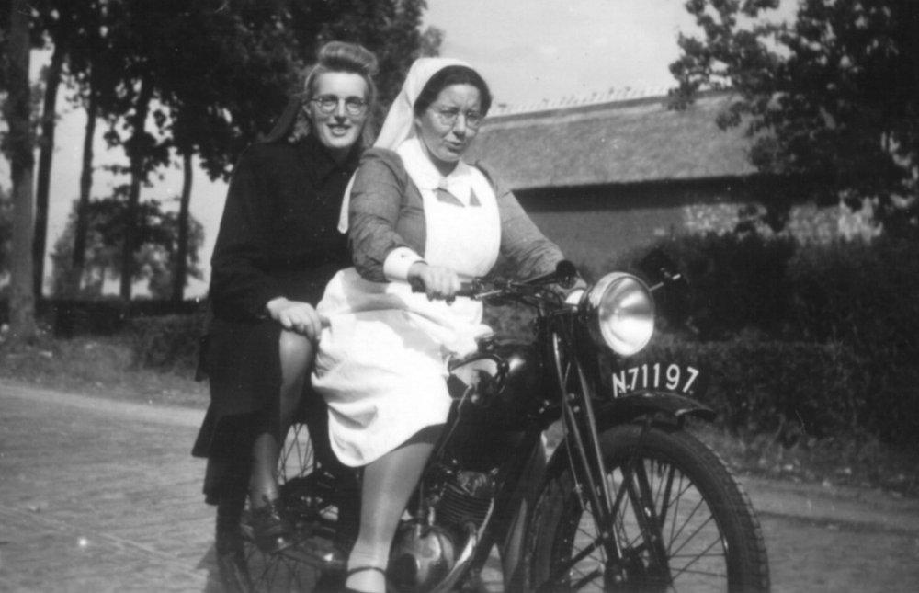
START 2007
Starting an organization and care delivery model for community care with:
independent teams up to 12 nurses
Working in a neighborhood of 5.000-10.000 people
Teams responsible for the organization and the complete process

Slide 4
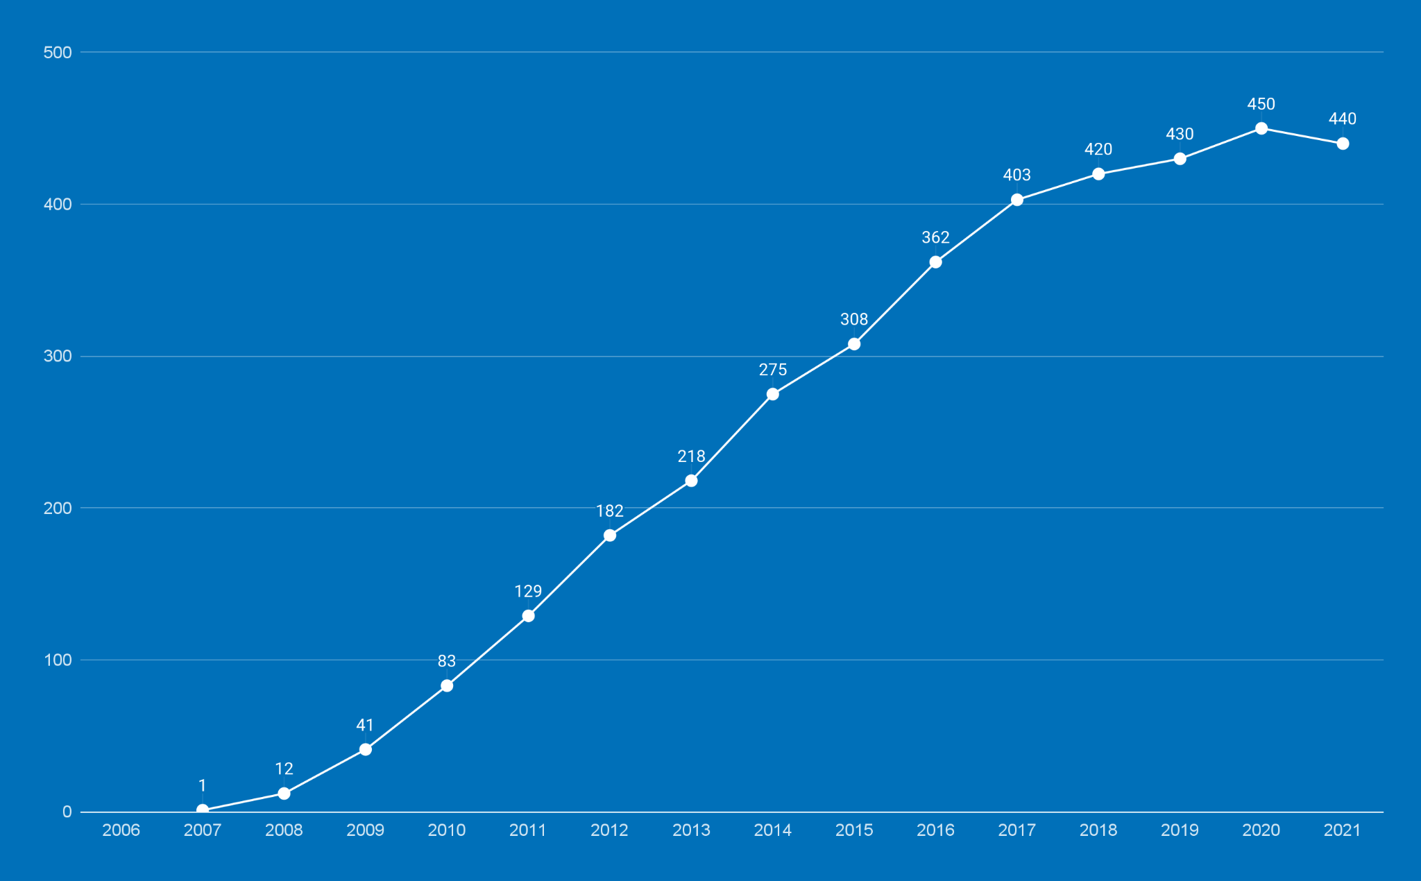
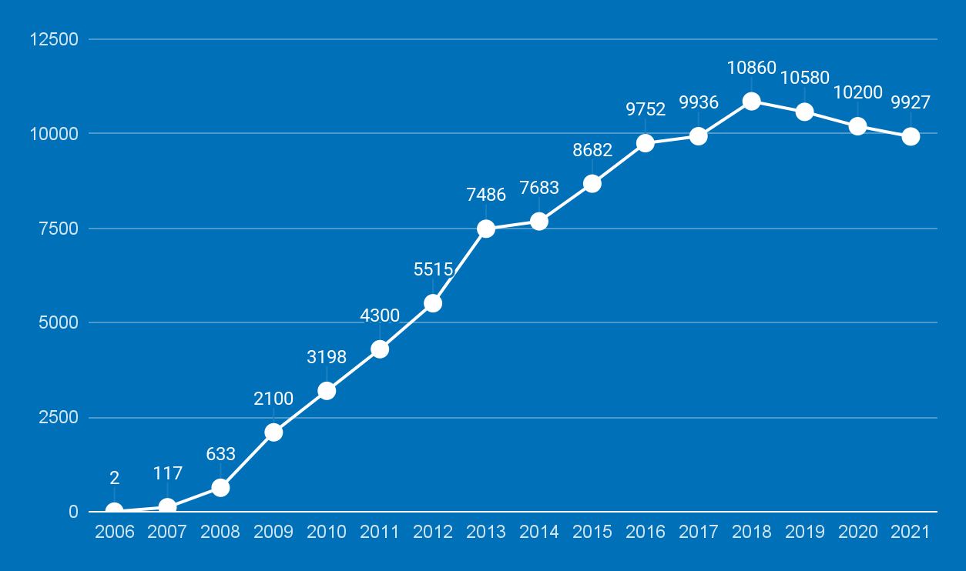
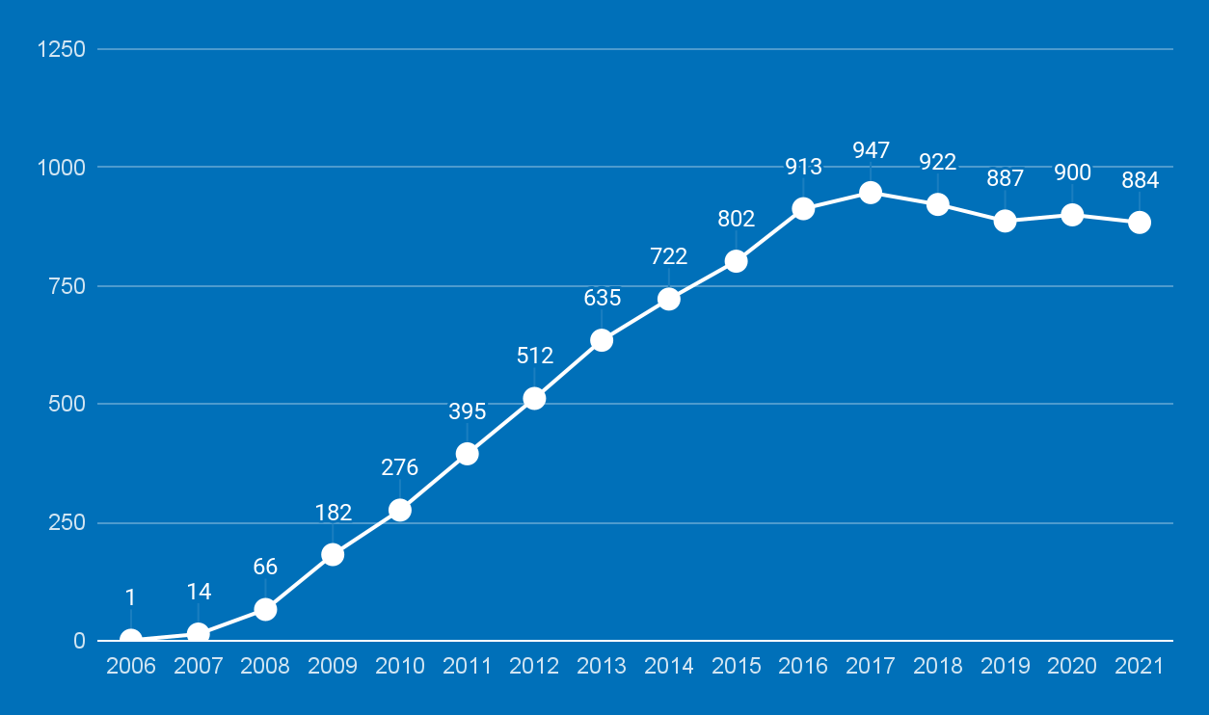
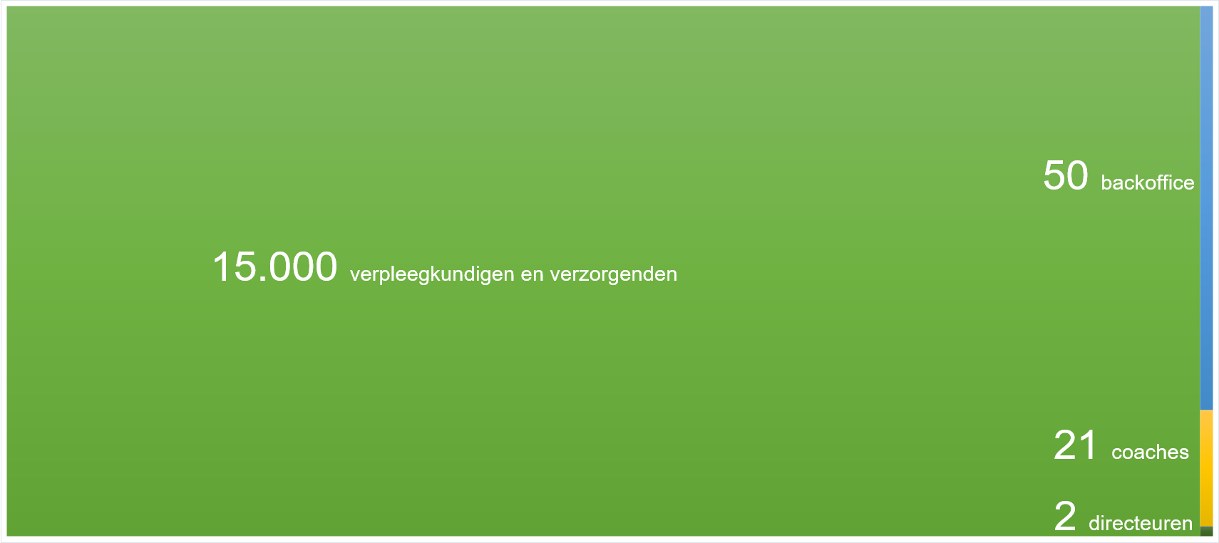
BUURTZORG 2007 - NOW
TEAMS
NURSES
TURNOVER
100 new nurses a month
100.000 + patients a year
510.000.000 turnover a year
15.000 nurses and careworkers

Slide 5
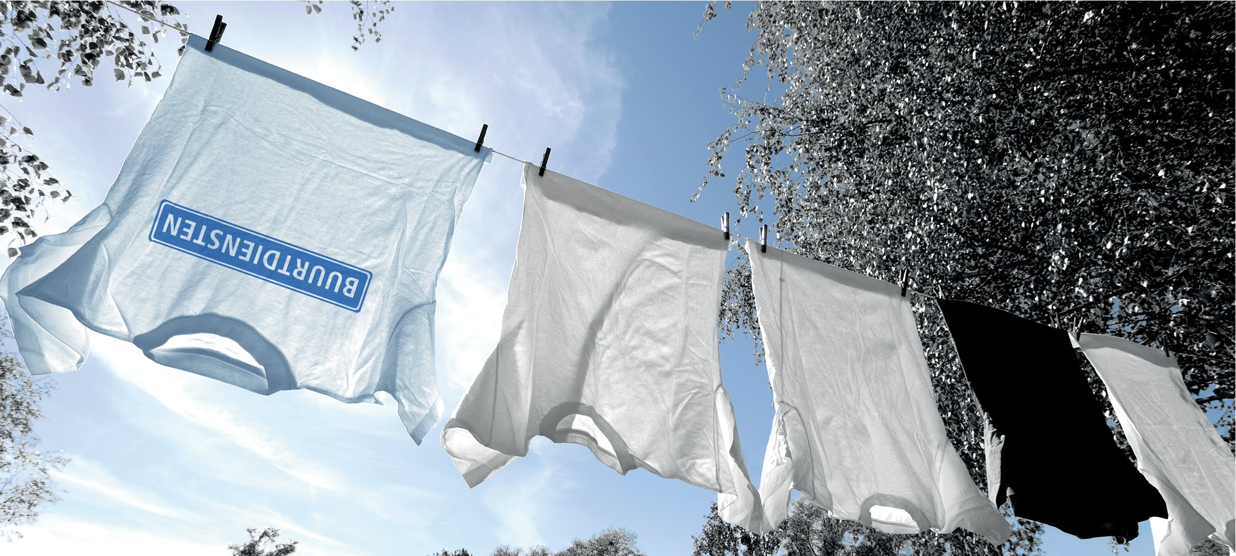
AN EXTRA EXISTING ORGANIZATION...
since 2016
4000 extra colleagues
successful
Notes:
Het verhaal achter het toevoegen van een bestaande organisatie aan de Buurtzorg boom

Slide 6
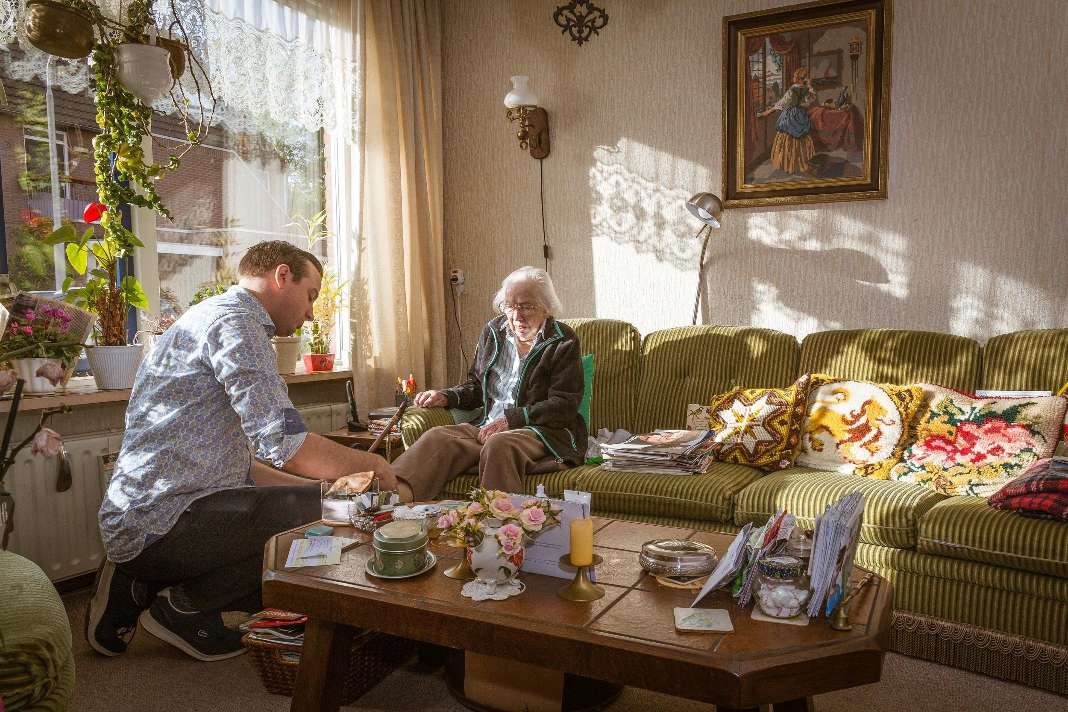
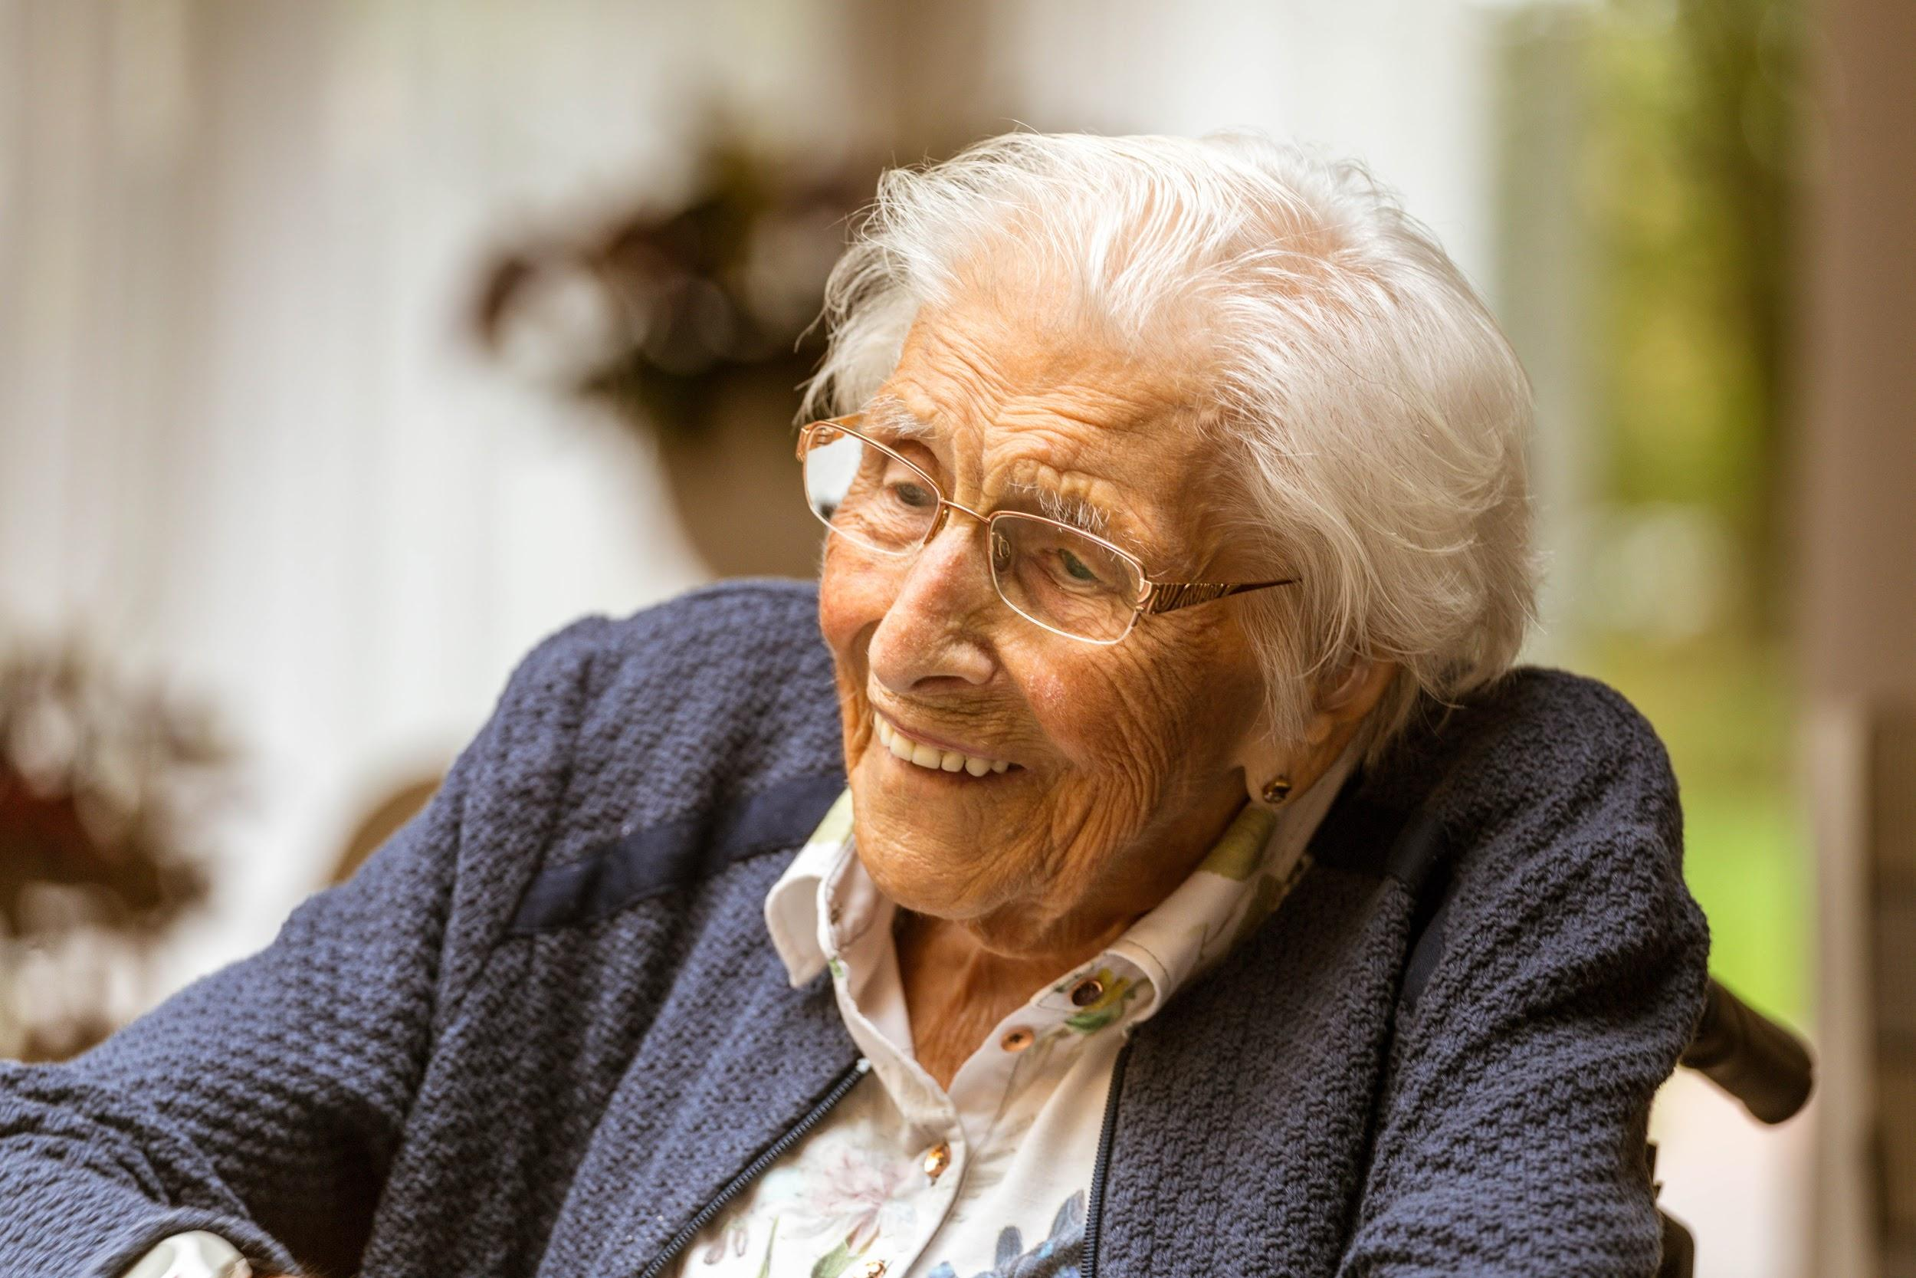
ONION MODEL
formal networks
CLIËNT
buurtzorgteam
informal networks
self management client
inside out | empowering and adaptive | network creating | supporting | additional | replacement

Slide 7
© 2019 Buurtzorg International Holding BV - All Rights Reserved

Slide 8
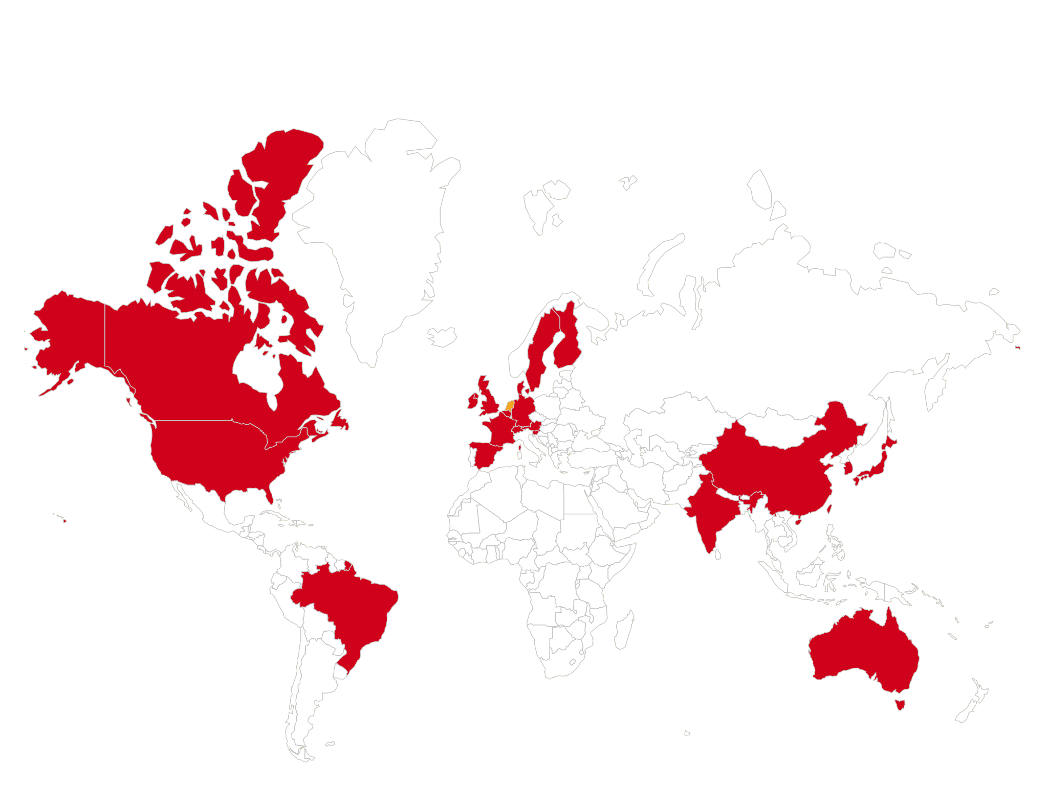
BUURTZORG INTERNATIONAL
Notes:
bron: piktochart.com - inlog h.vanraalte@buurtzorg.com, ww 5pXknA7ZWlPCt#R

Slide 9
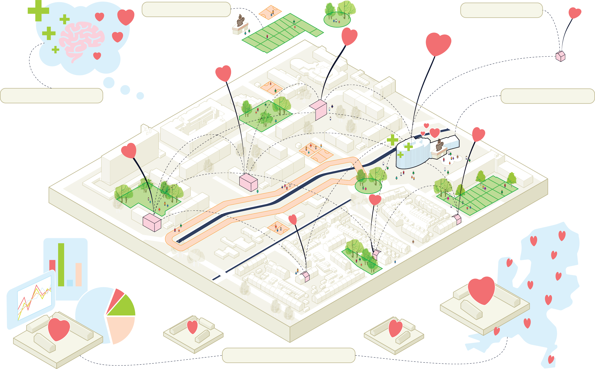
Our future vision
Caring Neighborhood
Int. primary care
We create neighborhoods in order to adopt social connections and promote health
We strengthen the connection and collaboration between primary care professionals in the neighborhood
Prevention as a mindset
Treatment closeby
We increase the independence of people and its network and bank on collective prevention
we make sure that people receive specialist care and, rehabilitate in their own neighborhood
The Learning Neighborhood
We ensure that we gain better insight at the neighborhood level into what we do and what it yields. This creates a network of knowledge exchange between neighborhoods so that good projects can be quickly scaled up.
Notes:
bron: piktochart.com - inlog h.vanraalte@buurtzorg.com, ww 5pXknA7ZWlPCt#R

Slide 10
Vision and underlying themes of our transition plan
Vision: The neighborhood as an ecosystem for social care. Healthcare in the neighborhood, small scale, simple, and integral. Starting from the person and together with their network. Trust and human connection as the foundation.
How do we design neighborhoods so that social connectedness is created and health is stimulated?
The caring neighborhood
Overarching themes
How do we ensure that we have a better understanding on the neighborhood level of what we are doing and what wo
The learning neighborhood
Prevention mindset
Connected 1st line
Treatment close by
How do we strengthen the resilience of people and their networks, and focus on collective prevention?
How do we strengthen the connection and collaboration between primary care professionals in the neighborhood?
How do we ensure that people receive specialist treatment and rehabilitation in the neighborhood?
Notes:
bron: piktochart.com - inlog h.vanraalte@buurtzorg.com, ww 5pXknA7ZWlPCt#R

Slide 11
With our transition, we are aiming on different patterns
From organisational focused care system
…towards social care
Fragmented system
Care is integrated, holistic and client-centered
Separation of activities/ more specialists
Simplification by integration of care activities
Focus on cure
Movement towards prevention
Transactional care
Relational care
Efficient and task-oriented work
Focus on outcomes
Hierarchical separation of thinking/doing
Self-management/autonomy for professionals
Focus on client-satisfaction
Increasing problem solving capacity client and network
Notes:
bron: piktochart.com - inlog h.vanraalte@buurtzorg.com, ww 5pXknA7ZWlPCt#R

